Slide 1
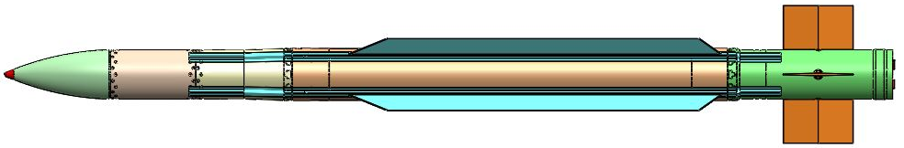
MISSILES
T.MOHAN REDDY

Slide 2
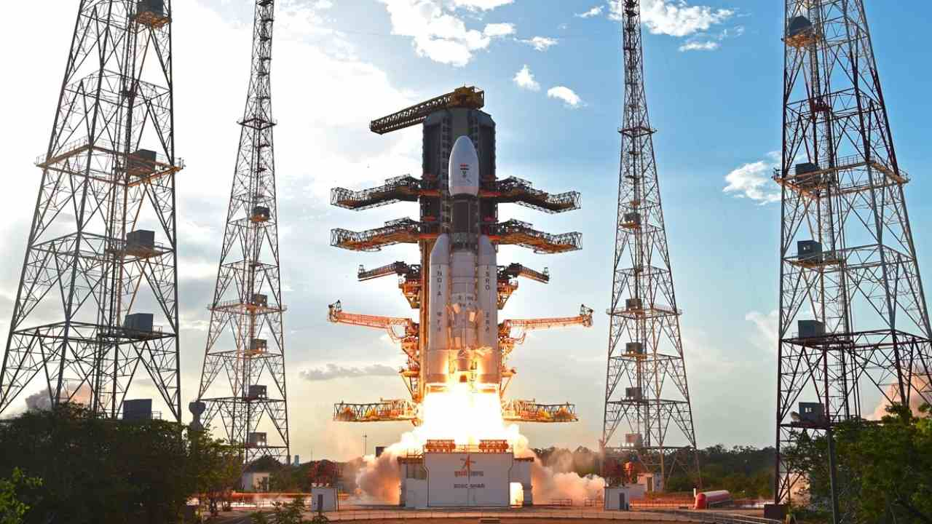

Slide 3
MISSILE – Made simple
Missile is always guided, while Rocket does not have guidance
(However INS/GPS Guidance are being adopted for Rocket and Bombs to reduce the cost of target engagement)
PRESENTATION COVERS
  Parts of Missiles
  Classification of missile
  Guidance and Navigation used in Missiles
Torpedo is also a under water Missile adopting different Technology for Guidance – SONAR, Propulsion by Batteries

Slide 4
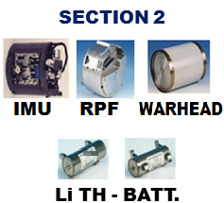
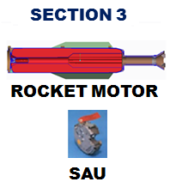
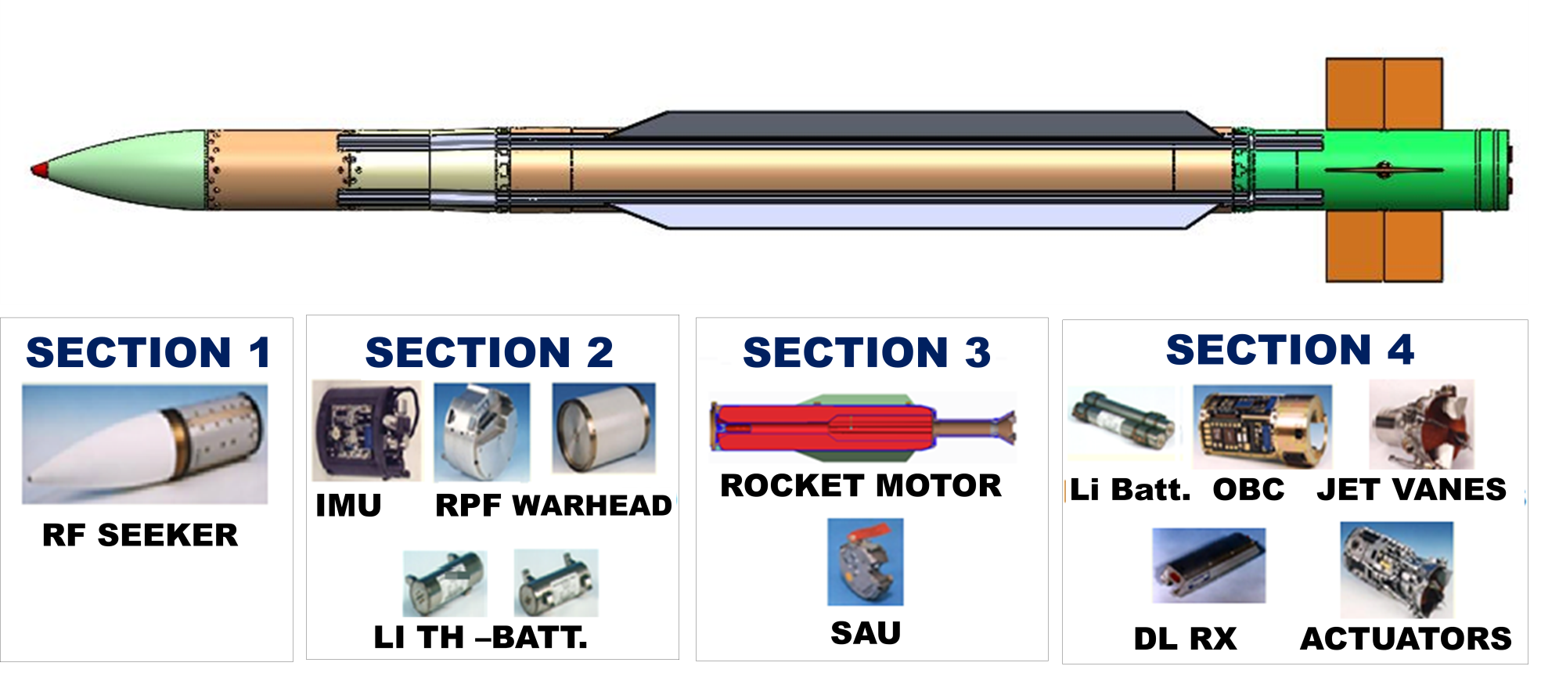
PARTS OF MISSILES

Slide 5
MISSILE | RANGE KM | AIRFRAME | PROPULSION | GUIDANCE | SEEKER | WARHEAD
ATGM
KONKORS-M | 4.0 | Al. Alloy (HE-15) & Composite FRP | Solid DB | Wire Guidance | NA | Tandem
NAG | 4 | Al-Alloy (HE-15) | Solid DB (NCNG-RDX) | Seeker | IIR Seeker (Imaging Infrared ) | Tandem
HELINA | 7 | Al-Alloy (HE-15) | Solid DB (NCNG-RDX) | Seeker | IIR Seeker | Tandem
SPIKE MR | 2.5 | Al-Alloy (HE-20) | Solid DB Composite | Seeker | IIR Seeker | Tandem
SPIKE LR | 4.0 | Al-Alloy (HE-20) | Solid DB Composite | Seeker | IIR/CCD (Charge coupled Device) | Tandem
SPIKE ER | 8.0 | Al-Alloy (HE-20) | Solid DB Composite | Seeker | IIR/CCD | Tandem

Slide 6
MISSILE | RANGE KM | AIRFRAME | PROPULSION | GUIDANCE | SEEKER | WARHEAD
SAM
AKASH | 25 | HE-20+ MDN-250 | Composite +Fuel rich (Ramjet) | CLOS (command to line of site) | NA | Pre Fragmented
AKASH S | 25 | HE-20+ MDN-250 | Composite + Fuel rich (Ramjet) | CLOS + Seeker | RF (KU-Band) | Pre fragmented
AKASH NG | 70 | HE-20+ MDN-250 | Composite | CLOS + Seeker | RF (KU-Band) | Pre fragmented
MRSAM | 70 | HE-20+ MDN-250 | Composite | Inertial + Seeker | X-Band | Pre fragmented
LRSAM | 70 | HE-20+ MDN-250 | Composite | Inertial + Seeker | X-Band | Pre fragmented

Slide 7
MISSILE | RANGE KM | AIRFRAME | PROPULSION |  | GUIDANCE | SEEKER | WARHEAD
AAM
ASTRA | 80-110 | HE-20+ MDN-250 |  | Composite | INS+RF SEEKER | RF (KU-BAND) | Pre fragmented
ASTRA MK-II | 120+ | HE-20+ MDN-250 |  | Composite | INS+RF SEEKER | RF (KU-BAND) | Pre fragmented
ASM
NGARM | 40 | AA2014+ MDN-250 |  | Composite | PNG+BROAD BAND RF SEEKER | Passive Seeker (1-18GHz) | Airburst / Impact
CRUISE
BRAHMOS | 300 | Al. Alloy (HE-20 &HE-15)+MDN |  | Composite+Liquid Ramjet | INS+RF Seeker + RF Altimeter | X-Band | Impact
BRAHMOS-NG | 600 | Al. Alloy (HE-20&HE-15)+MDN |  | Composite+Liquid Ramjet | INS+RF Seeker + RF Altimeter | X-Band | Impact
Note: MDN-250 (Maraging Steel) is used for Rocket Motor

Slide 8
MATERIAL PROPERTIES
MDN -250 (MARAGING STEEL)
C | <0.02%
Si | <0.1%
Mn | <0.1%
P | <0.01%
Ni | 18%
Cr | 0.25%
Co | 8%
Mo | 4.5%
Ti | 0.5%
Al | 0.05-0.15
Fe | >64
Mechanical Properties
UTS | 170kg/mm2
Elongation | 8-10 %
 | HE-20 ALUMINIUM AA 6063 | HE-15, ALUMINUM-2014A
Al | Max 97.5% | 90.8 – 95%
Cr | Max 0.1% | Max 0.1%
Cu | Max 0.1 | 3.9 – 5.0 %
Fe | Max 0.35 | Max 0.5 %
Si | 0.2-0.6 | 0.5 to 0.9 %
Ti | Max 0.1 | Max 0.15%
Zn | Max 0.1 | Max 0.25%
Mg | 0.45 – 0.9 | 0.2 – 0.8 %
Mn | Max 0.1 | 0.4 – 1.2 %
Mechanical Properties
UTS | 25kg/mm² |  | 38 kg/mm²
Elongation | 6-8 % |  | 10 %

Slide 9
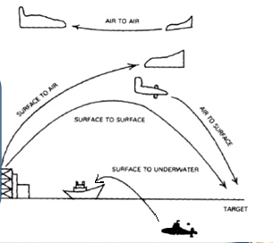
MISSILE IS CLASSIFIED BASED ON:
CLASSIFICATION | TYPES
LAUNCH PLATFORM | SAM(AKASH), SSM(AGNI), AAM(ASTRA), ASM(ARM)
TARGET ENGAGEMENT | Antitank (NAG), Anti Aircraft(ASTRA), Anti Ship (Brahmos) Anti Radars (NGARM)
RANGE | SR, MR, LR, ER (ATGM’s) SRBM, MRBM, IRBM & ICBM (Strategic Missiles)
GENERATIONS / TECHNOLOGY | ATGM-(Wire Guided, Semi Automatic, Automatic/Fire and Forget or Lock on before launch) Advance Technology Kinetic Energy Projectile (Mach: 3 to5)

Slide 10
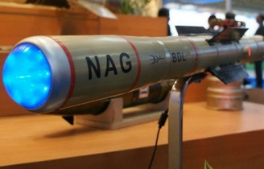
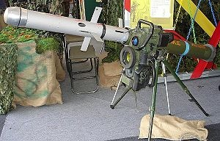
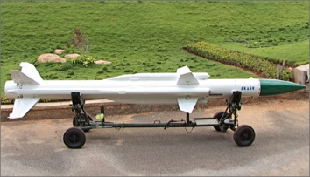
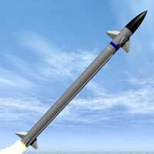
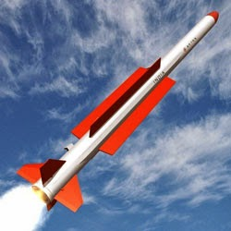
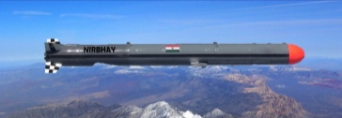
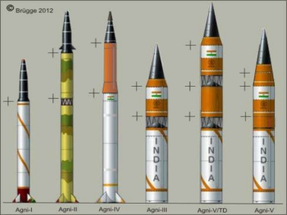
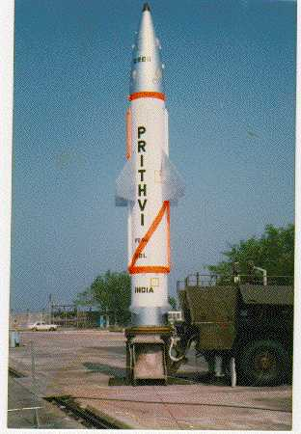
CLASSIFICATION OF MISSILES:
ANTI TANK GUIDED MISSILE (ATGM) | NAG/HELINA, SPIKE MR, LR, ER
SURFACE TO AIR MISSILE (SAM) | AKASH, LRSAM, MRSAM
AIR TO AIR MISSILE (AAM) | ASTRA, R-70, R-63
AIR TO SURFACE (ASM) | NIRBHAY
SURFACE TO SURFACE (SSM) | AGNI-I, II, III, IV & V PRITHVI-I, II,III & DHANUSH, K-15

Slide 11
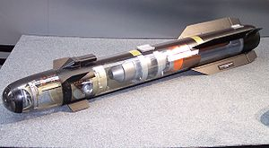
Anti Tank Guided Missile (ATGM)
Surface to Air Missile (SAM)
Air to Air Missile (AAM)
Air to Surface (ASM)
Surface to Surface (SSM)

Slide 12
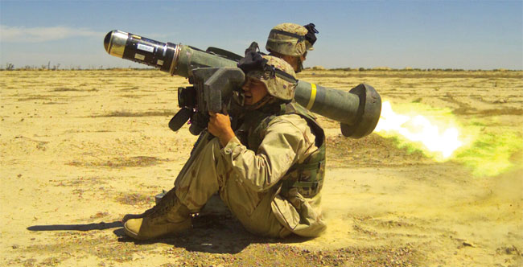
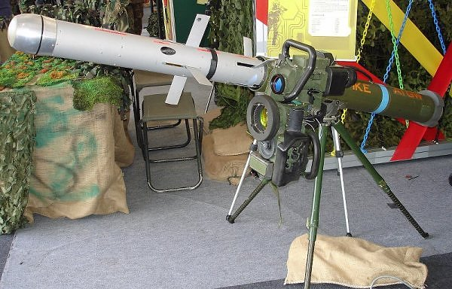
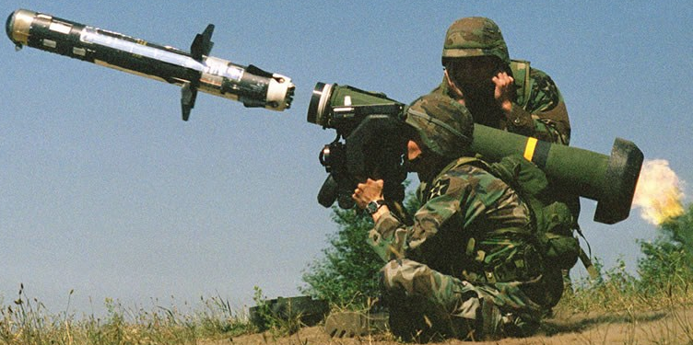
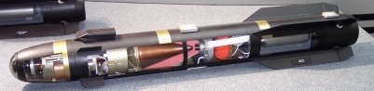
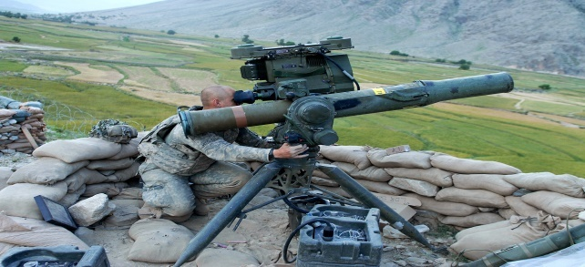
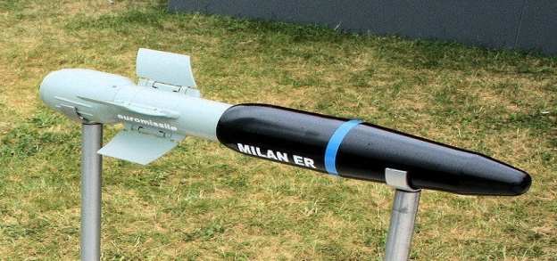
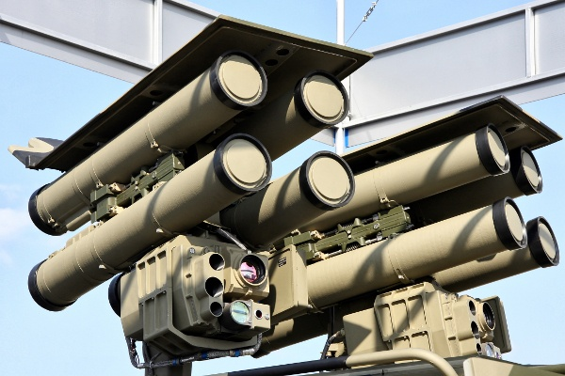
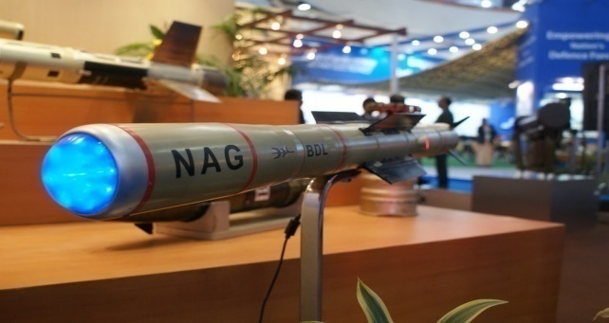
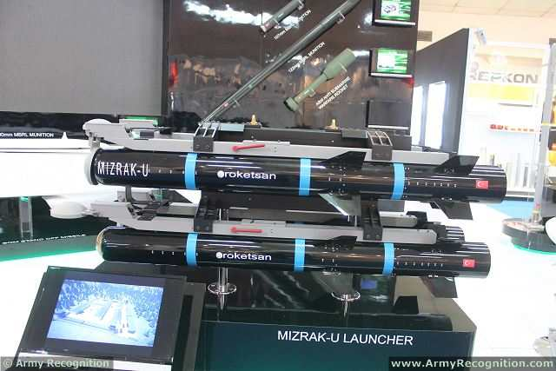
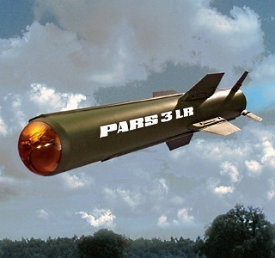
ANTITANK GUIDED MISSILES
US
ISRAEL
US
AGM-114R HELLFIRE
Spike-MR/LR/ER
Javelin Missile
US
FRANCE
RUSSIA
BGM-71 TOW
MILAN ER
Kornet-EM
INDIA
TURKISH
GERMANY
Nag (missile)
Mızrak-U
PARS 3 / TIGRAT

Slide 13
ATGM : ANTI-TANK GUIDED MISSILE
FIRST-GENERATION
Manually command guided MCLOS missiles require input from an operator.
The disadvantage is that the operator must keep the sight's cross hairs on the target. (line-of-sight)
SECOND-GENERATION
semi-automatically command guided SACLOS missiles require the operator to only keep the sights on the target until impact.
Automatic guidance commands are sent to the missile through wires or radio, or the missile relies on laser marking or a TV camera view from the nose of the missile.
THIRD-GENERATION
Guidance systems rely on a laser, electro-optical imager (IIR) seeker or a W-band radar seeker in the nose of the missile.
Once the target is identified, no further guidance during flight; it is "fire-and-forget", and the missile operator is free to retreat.
FOURTH GENERATION
ATGM’s with Dual Mode Seeker and ability to Lock-on After Launch.
RANGE
Min 17M (Predator)
Max 25,000M (SPIKE NLOS)
WEIGHT
Min 6.1kg
Max 70 kg
TYPE OF WARHEAD
Single Explosive HEAT
Tandem HEAT
Thermobaric
TECHNOLOGIES
Laser beam-riding (man-the-loop)
Fiber-optic guided (fire-and-adjust)
Imaging infrared (fire-and-forget)
TARGET TYPE
Top attack
Front attack

Slide 14
INDIAN ARMY MISSILES | TYPE | ORIGIN | RANGE (KM) | PLATFORM
SPIKE (MISSILE) | ATGM | Israel | 1.5-25 | Man Portable, Vehicle
NAG MISSILE | ATGM | India | 5.4 | Vehicle
MILAN | ATGM | France MBDA | 1.5 | Man Portable, Vehicle
MILAN 2T | ATGM | France MBDA | 3.0 | Man Portable, Vehicle
KORNET | ATGM | Russia | 5.5 | Man Portable, Vehicle
KONKURS | ATGM | Russia & India | 0.7-4 | Man Portable, Vehicle
3UBK-INVAR | ATGM | Russia & India | 5.0 | 125 mm smoothbore guns
HELINA | Air launched | India | 8.0 | Helicopter / Aircraft

Slide 15
OTHER ATGM’S
NAME | COUNTRY | RANGE IN MTS (MIN - MAX) | MISSILE SPEED(M/SEC) | GUIDANCE
HELLFIRE | US | 500 - 8000 | 450 | Semi-active laser homing
JAVELIN | US | 50 - 2500 | 277 | LWIR
TOW | US | 100 - 4200 | 320 | Optically tracked
BRIMSTONE | UK | 200 - 60000 | 450 | Laser
SPIKE | Israel | 200 - 25000 | 250 | IR homing
KORNET | Russia | 100 - 5500 | 347 | Laser SACLOS
NAG | India | 70 - 4000 | 230 | IIR, (MMW-Under Development)

Slide 16

Anti Tank Guided Missile (ATGM)
Surface to Air Missile (SAM)
Air to Air Missile (AAM)
Air to Surface (ASM)
Surface to Surface (SSM)

Slide 17
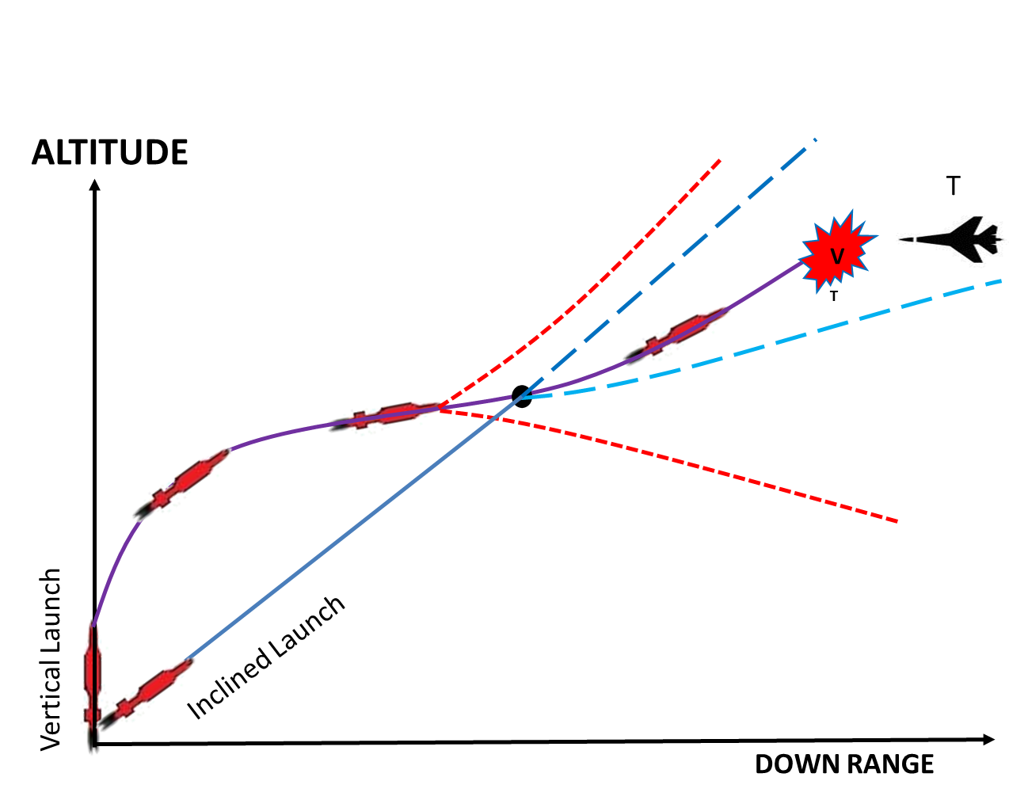
SURFACE TO AIR MISSILE
A surface-to-air missile (SAM), is a missile designed to be launched from the ground to destroy aircraft or other arieal targets.
RANGE :
World : 9Km - 780Km
INDIAN :12km-180km
TYPES OF SAM:
LRSAM : 70Km
SRSAM : <15Km
MRSAM : 70Km
CONTROL & GUIDANCE
Radio control command guidance.
Command + electro optical tracking
Semi-Active Radar Homing
Active Radar Homing
Passive RF + ImIR
Inertial Mid course
Dual mode command
Command guidance system
Radar CLOS Guidance
Infrared Homing

Slide 18
Types of Missile (Surface to Air)
 | RUSSIAN |  | AMERICAN |  | INDIA | ISRAEL
NAME OF THE MISSILE | SA-2 (S-75 Dvina) | SA-7 (9K32 Strela-2 ) | FIM-92 STRINGER | MIM-104 PATRIOT | AKASH | SPYDER (Python – Derby)
RANGE | 45Km | 4Km | 8Km | 70Km | 30Km | 7-15Km
WEIGHT | 2,300Kg | 15Kg | 15Kg | 700Kg | 720Kg | 105Kg
PROPELLANT FUEL | Solid-fuel booster and Liquid-fuel Sustainer | Solid Propellant | Solid propellant | Solid Propellant | Solid Ramjet Propulsion | -
TECHNOLOGY | Command guidance | Proportional Navigation Logic | Infrared Homing | Track via Missile(Radio command + SAH) | Command Guidance | IR homing and EO imaging (Python-5) Active radar homing (derby)
SPEED | Mach 3.5 | Mach 1.2 | Mach 2.5 | Mach 2.8 | Mach 2.5+ | Mach 4

Slide 19
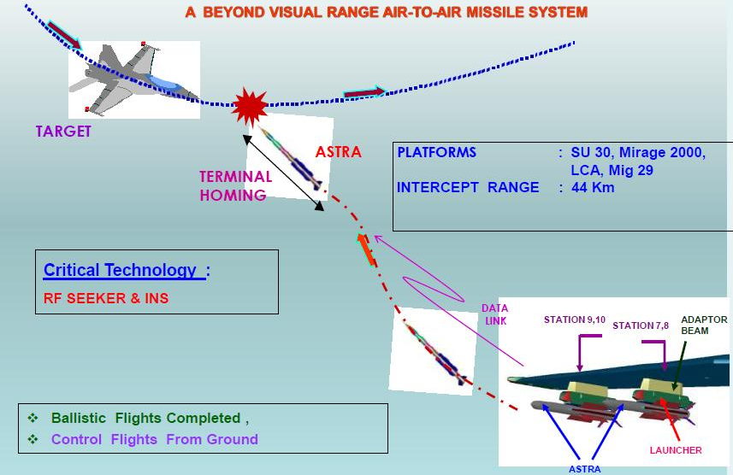
Anti Tank Guided Missile (ATGM)
Surface to Air Missile (SAM)
Air to Air Missile (AAM)
Air to Surface (ASM)
Surface to Surface (SSM)

Slide 20
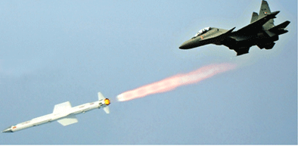
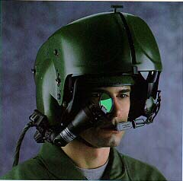
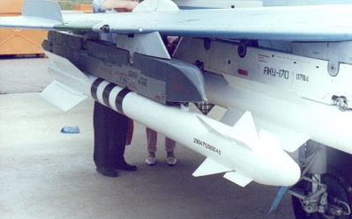
AIR TO AIR MISSILE
Air-to-Air missile (AAM) is a missile fired from an aircraft for the purpose of destroying another aircraft (Anti-Aircraft Missile).
A missile's effective range is dependent on factors such as altitude, speed, position, and direction of the target aircraft as well as those of the attacking aircraft.
RANGE
India : Up to 110 kms
World : Up to 400 kms
GUIDANCE SYSTEM
Radar
Active radar homing
Semi-active radar homing
Beam riding
Infrared
Electro-optical
Passive Anti-radiation
Helmet Guided Missile
HELMET GUIDED MISSILE - R-73 (RUSSIAN MISSILE)
The R-73 is an infrared homing (heat-seeking) missile with a sensitive, cryogenic cooled seeker with a substantial "off-bore sight" capability. It can see 40° off the missile's centerline.
It can be targeted by a helmet-mounted sight (HMS) allowing pilots to designate targets by looking at them.
Minimum engagement range is about 300 meters, with maximum aerodynamic range of nearly 30 km (19 mi) at altitude.
Helmet Guided
R – 73

Slide 21

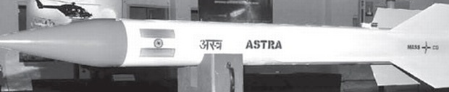
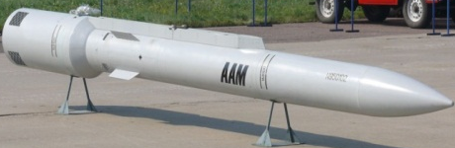
TYPES OF MISSILE (AIR TO AIR)
COUNTRY OF ORIGIN | ROCKET NAME | RANGE (KM) | WEIGHT (KG) | WARHEAD WEIGHT (KG) | WARHEAD TYPES
RUSSIA | Vympel R-73 | 20 – 40 | 105 | 7.4 | Fragmentation
FRANCE | MBDA MICA-EM/-IR | > 60 | 112 | 12 | Blast/fragmentation
USA | Raytheon AIM-9 Sidewinder | 18 | 86 | 9.4 | Annular blast fragmentation
GERMAN | Diehl IRIS-T | 25 | 87.4 | 11.4 | HE/fragmentation
UK | MBDA AIM-132 ASRAAM | 50 | 88 | 10 | Blast/fragmentation
ISRAEL | Rafael Derby | 50 | 118 | 23 | Blast/fragmentation
INDIA | Astra | 80 - 110 + | 154 | 15 | HE fragmentation directional
AAM-4
ASTRA
Novator K-100

Slide 22

Anti Tank Guided Missile (ATGM)
Surface to Air Missile (SAM)
Air to Air Missile (AAM)
Air to Surface (ASM)
Surface to Surface (SSM)

Slide 23
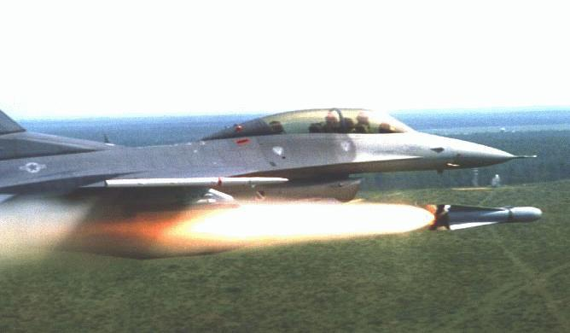
AIR TO SURFACE MISSILE
An air-to-surface missile (ASM) or air-to-ground missile (AGM ) is a missile designed to be launched from military air crafts at targets on land or sea.
RANGE
World:3 KM -5000 KM
India:7 KM – 300 KM
Subcategories of air to surface missile
TYPES
Cruise Missile
Ballistic Missile
Anti radiation missile
Air-launched anti-tank guided missile
(typically launched from helicopters)
Air-launched cruise missiles
Air-launched anti-ship missiles
WARHEAD
Conventional
Nuclear
GUIDANCE SYSTEM
Laser guidance
Infrared guidance
Optical guidance
satellite guidance

Slide 24
TOP MISSILES(AIR TO SURFACE) IN THE WORLD
Classification based on range
INTERMEDIATE RANGE MISSILE
COUNTRY | MISSILE | RANGE (KM)
MEDIUM RANGE MISSILE
COUNTRY | MISSILE | RANGE (KM)
USSR | As-15 Kent | 2500
USA | AGM-86B,86C | 1100-2400
UK | GAM-87 | 1850
China | CJ-10 | 1500
India | Nirbhay | 1000
SHORT RANGE MISSILE
COUNTRY | MISSILE | RANGE (KM)
UK | Blue Steel | 926
China | Changfeng | 800
USSR | KSR-5 | 700
Pakistan | Raad | 350
India | Brahmos | 600

Slide 25
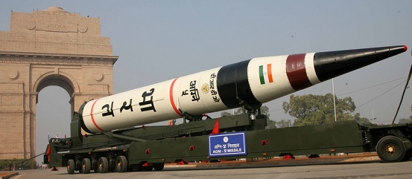
Anti Tank Guided Missile (ATGM)
Surface to Air Missile (SAM)
Air to Air Missile (AAM)
Air to Surface (ASM)
Surface to Surface (SSM)

Slide 26
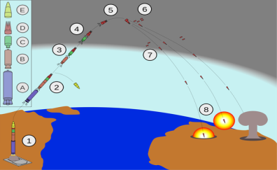
SURFACE TO SURFACE MISSILE
It’s a missile designed to be launched from the ground or at sea and strike targets on land or at sea.
RANGE
World:150KM-16,000KM
India: 150KM – 8,000KM
Ballistic missile is a missile that follows a ballistic trajectory with the objective of delivering one or more warheads to a predetermined target.
A ballistic missile is only guided during relatively brief periods of flight
TYPES
Cruise Missile
Ballistic Missile
Cruise Missile: a low-flying missile which is guided to its target by an on-board computer.
vehicle that sustains flight through aerodynamic lift for most of its flight path and whose primary
mission is to place an ordnance or special payload on a target. They fly within the earth’s atmosphere and use jet engine technology. These vehicles vary greatly in their speed and ability
Cruise missiles are generally associated with land-attack operations, but also have an important role as anti-shipping weapons
WARHEAD
Conventional
Strategic nuclear
GUIDANCE SYSTEM
Terrestrial Guidance
Inertial Guidance
Laser Guidance
RF and GPS Reference

Slide 27
CATEGORY | DESCRIPTION | RANGE | MISSILES
TBM | Tactical ballistic missile | 150 km to 300 km | Prithvi
BRBM | Battlefield range ballistic missile | Less than 200 km | Prithvi
SRBM | Short-range ballistic missile | Below 1000 km | Agni- I
MRBM | Medium-range ballistic missile | 1000km to 3000km | Agni- II
IRBM | Intermediate-range ballistic missile | 3000km to 5500km | Agni-III & IV
ICBM | Intercontinental ballistic missile | 5500km above | Agni-V & VI

